Slide 1

Multimedia Data in MATLAB

Slide 2
What kind of data I can process in MATLAB?
You can import pretty much any forms of data into MATLAB
As long as you can convert your data into numbers MATLAB is happy with it.
Some data types are more convenient to use than others in MATLAB.
Images, audio files and video files are very easy to use in MATLAB
Text and inhomogeneous data like excel files with different data types are harder to manipulate in MATLAB
In this tutorial we cover basic import/export and manipulation of multimedia files(image, audio and video) in MATLAB

Slide 3

What kind of data I can process in MATLAB?
Images, audio files and video files are very easy to use in MATLAB
Text and inhomogeneous data like excel files with different data types are harder to manipulate in MATLAB
In this tutorial we cover basic import/export and manipulation of multimedia files(image, audio and video)

Slide 4
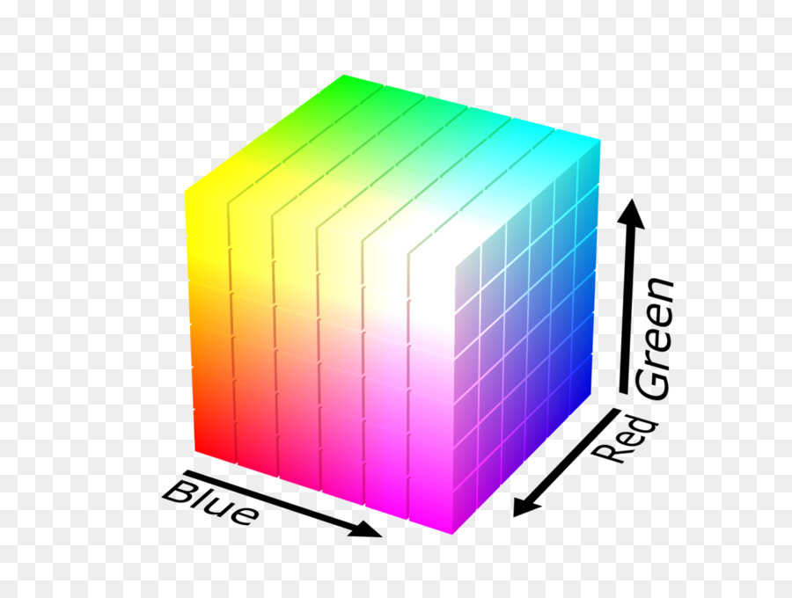
Basic Image processing
Digital images are basically 2d(grayscale) or 3d(colored) matrix of pixels.
Individual pixels are assigned a numerical value which represents a grayscale or color value.
For grayscale images, the color is a number in the range 0-255 (one byte of data, 0 for the darkest and 255 for the brightest color)
For color images in RGB color scheme it’s three numbers in the same range.

Slide 5
MATLAB can import/export several image formats:
JPEG (Joint Photographic Experts Group)
BMP (Microsoft Windows Bitmap)
PNG (Portable Network Graphics)
GIF (Graphics Interchange Files)
TIFF (Tagged Image File Format)
HDF (Hierarchical Data Format)
PCX (Paintbrush)
XWD (X Window Dump)
raw-data and other types of image data

Slide 6
Read and Display Images
You can read standard image files by using the imread function.
The type of data returned by this function depends on the input image.
In the case of this tutorial, the image parrots.jpg is “uint8.”
A = imread('parrots.jpg’);
A is a 600x900x3 matrix.
The first number shows the number of rows, the second is the number of columns, and the last one is the channels (RGB=Red, Green, Blue).

Slide 7
Read and Display Images
To show an image, you have to use the imshow function. Here we show the same picture again.
imshow(A);

Slide 8
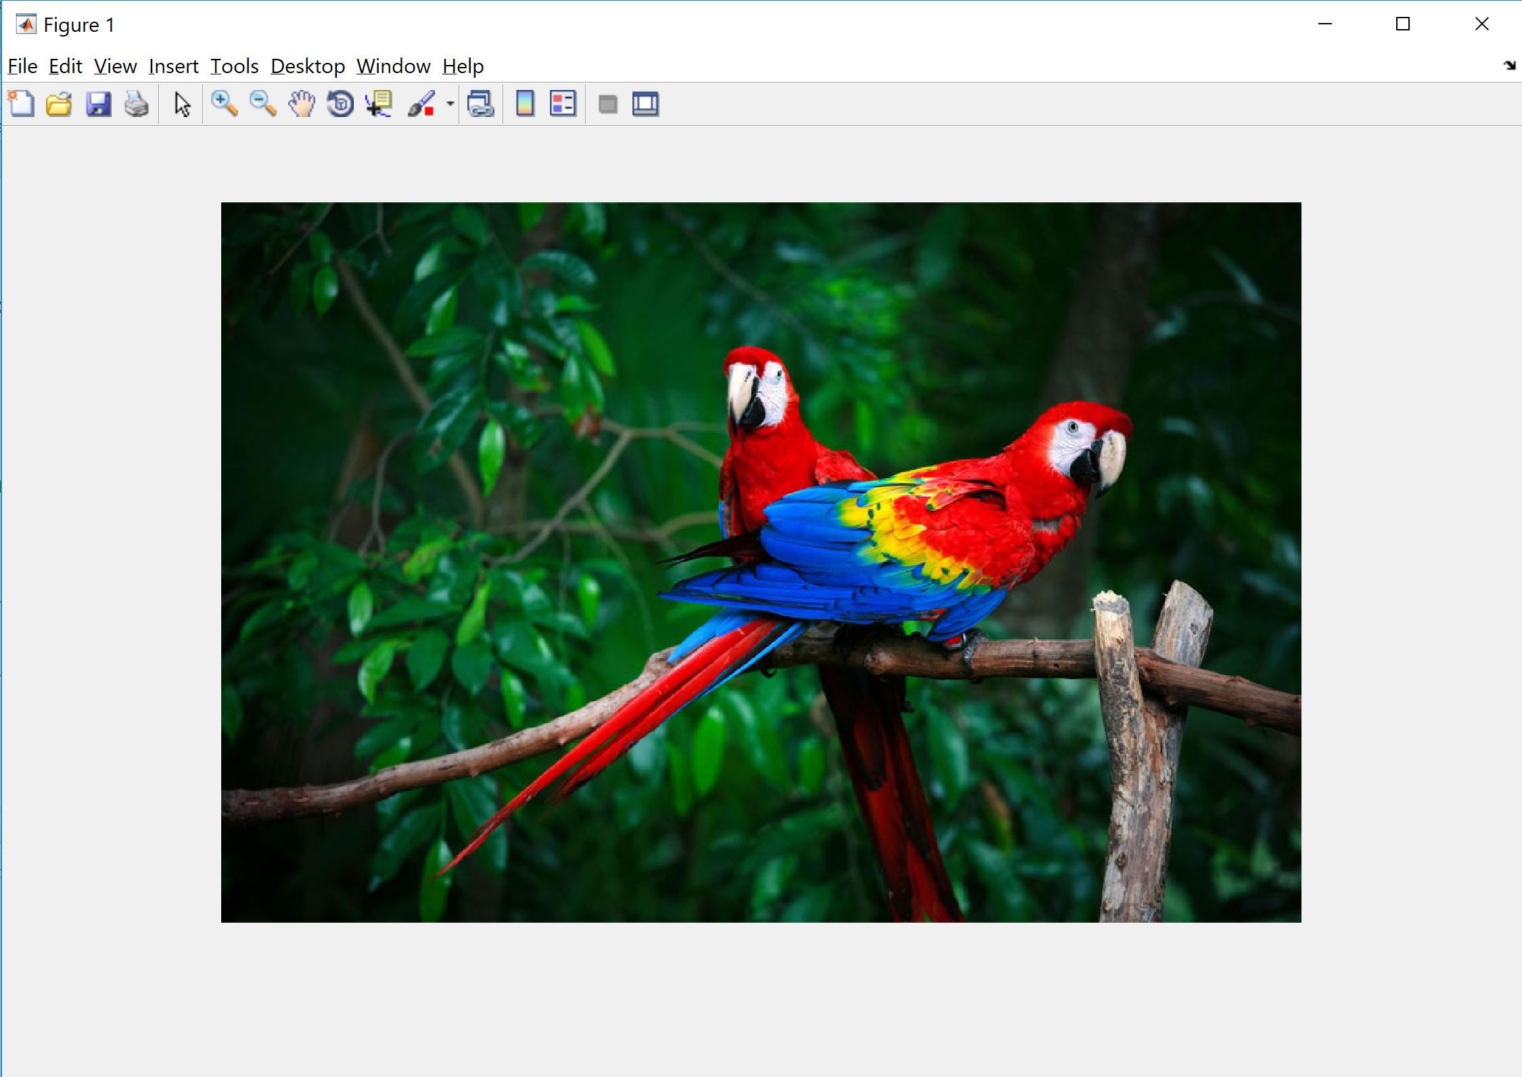

Slide 9
Read and Display Images
Black-white images are grayscale, so they have just one channel. In most image processing tasks, we turn colored images to grayscale to simplify the subsequent processes.
A_gray = rgb2gray(A);
A_gray size is 600x900. We can use imshow for the new matrix A_gray to see the result.

Slide 10
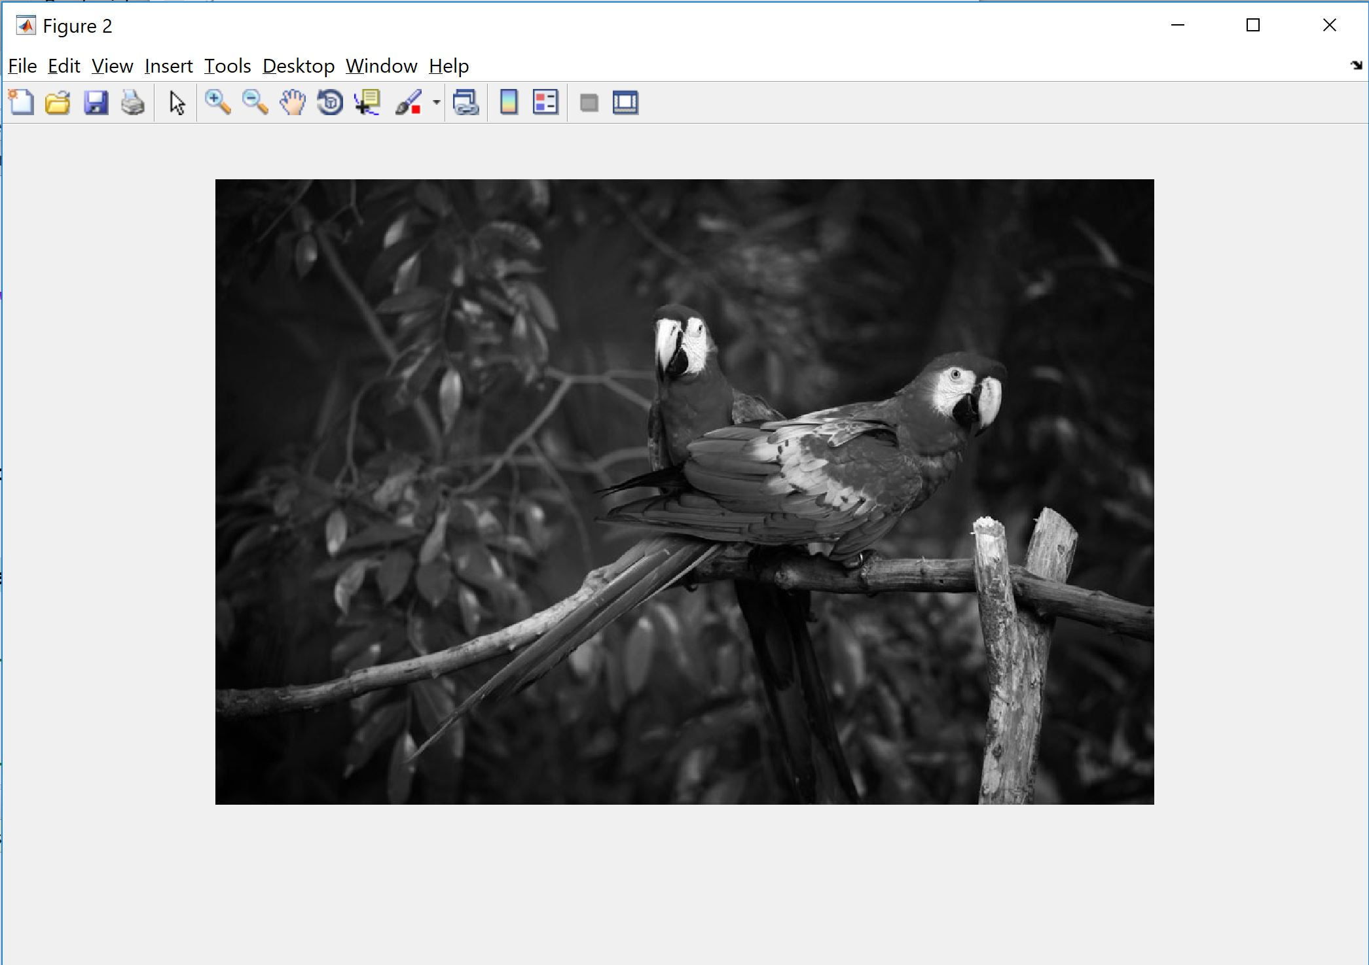

Slide 11
Write Image to Disk
After you process the image, you can save it on disk. You can use imwrite for this purpose.
imwrite(A_gray, 'gray_parrots.jpg');
Because an image is a matrix, then we can perform any mathematical operation on them and that’s where the fun starts!

Slide 12
Simple processing
For start, we can cut a part of the image just by addressing the matrix. As an example, we can do:
A_cutted = A_gray(200:400,300:600);
imshow(A_cutted)
You can also change the value of a single pixel or a group of them. For example, we can create a white rectangular by changing the value of some pixels to 255 (whitest color):
A_gray(55:100,55:100)=255;

Slide 13
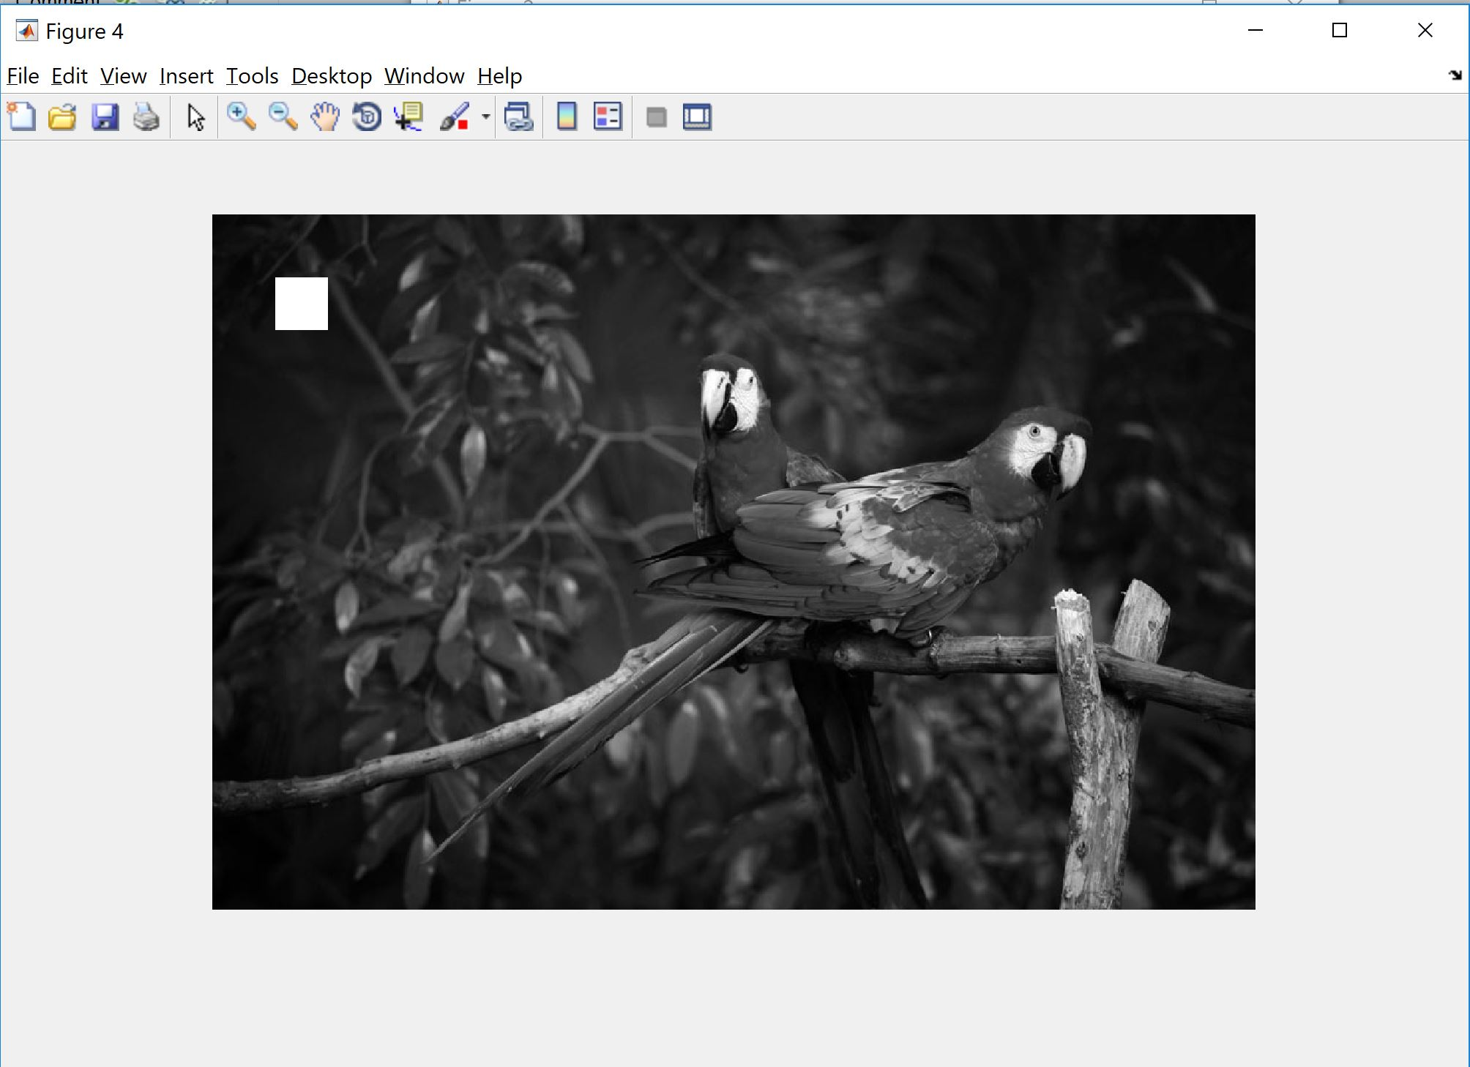
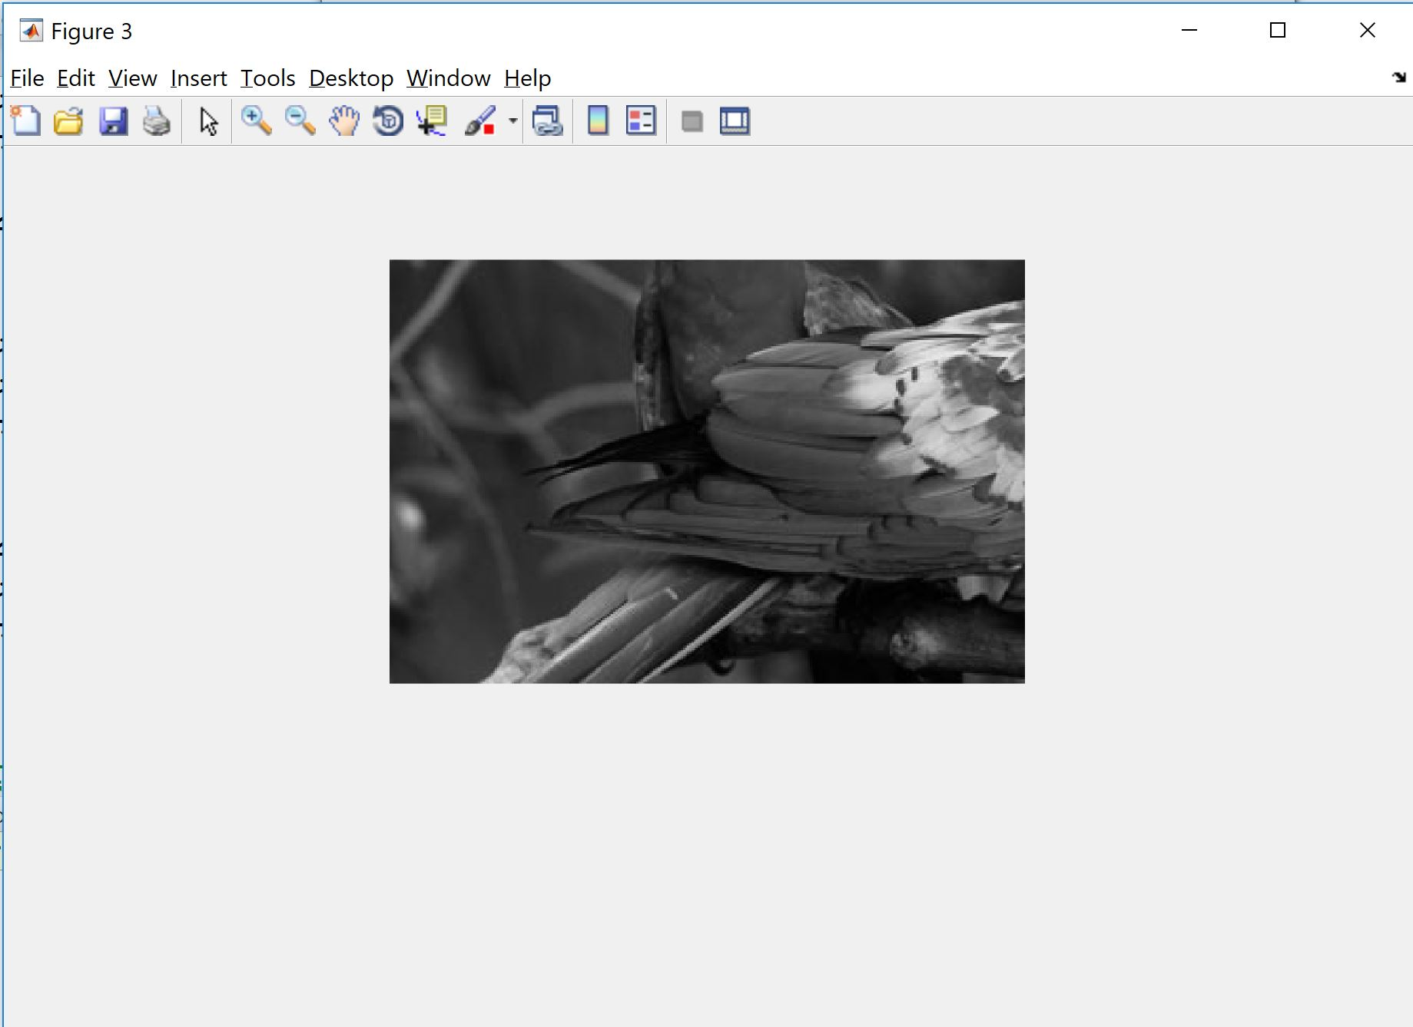

Slide 14
Simple processing
We can also change the intensity of pixels by multiplying them by a number
Make it brighter:
A_brightened = A_gray*2;
Make it darker
A_darkened = A_gray*0.5;

Slide 15
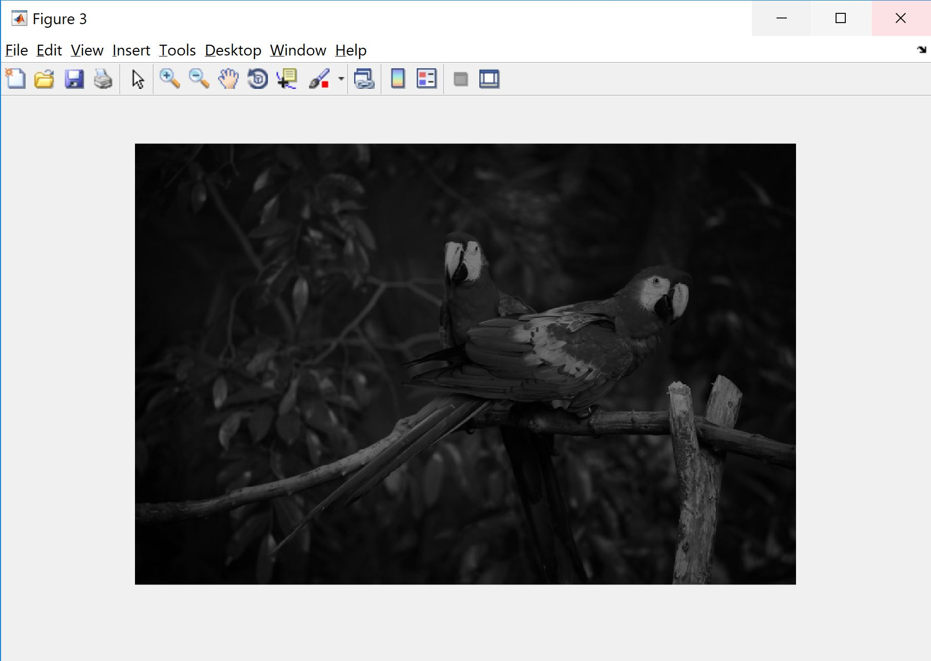
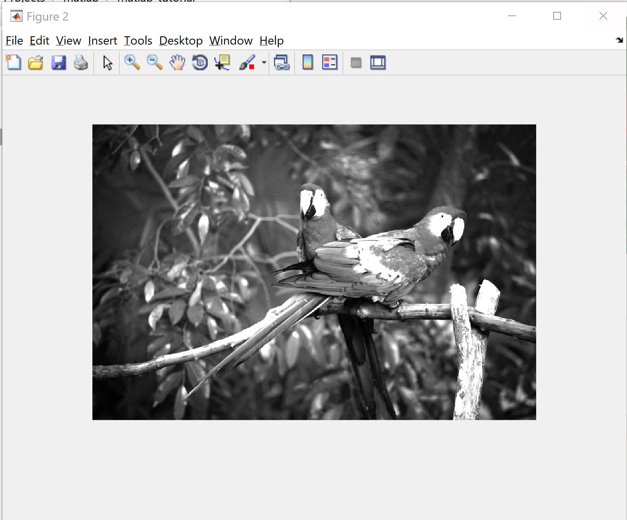

Slide 16
Image histogram
Each pixels’ brightness varies, and we can look for frequency of their brightness in the scale of 0-255. For example, how many pixels have the intensity of 10? We can collect all of this data and show it in a histogram. The x-axis displays the intensity from 0 to 255 and the y-axis shows how many pixels we have for each intensity. For this purpose, MATLAB has a predefined function:
imhist(A_gray)
And the result on the parrots image is:

Slide 17
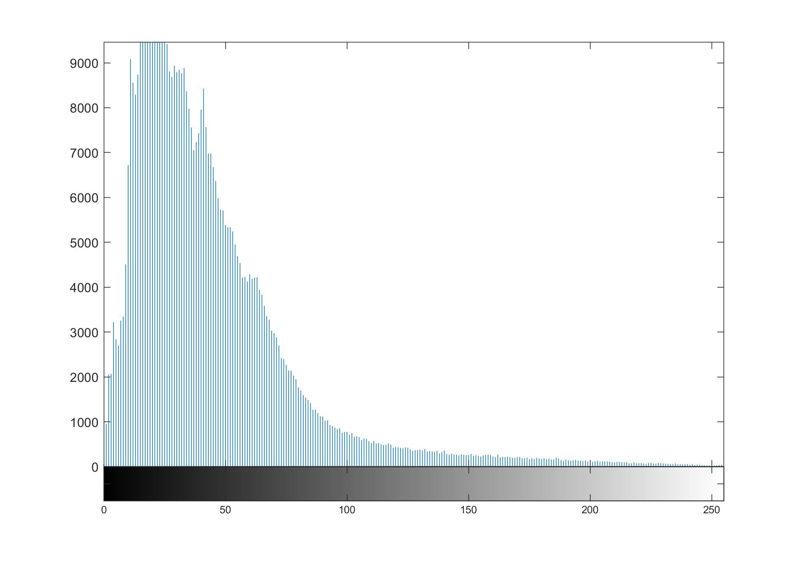

Slide 18
Image histogram
As you can see the brightness is concentrated in the dark area of grayscale.
Histogram equalization spreads the intensity values over the full range of the image and improves the contrast in an image.
A_gray_eq = histeq(A_gray);
As you can see, the contrast is higher and you can see more details especially in the background.

Slide 19
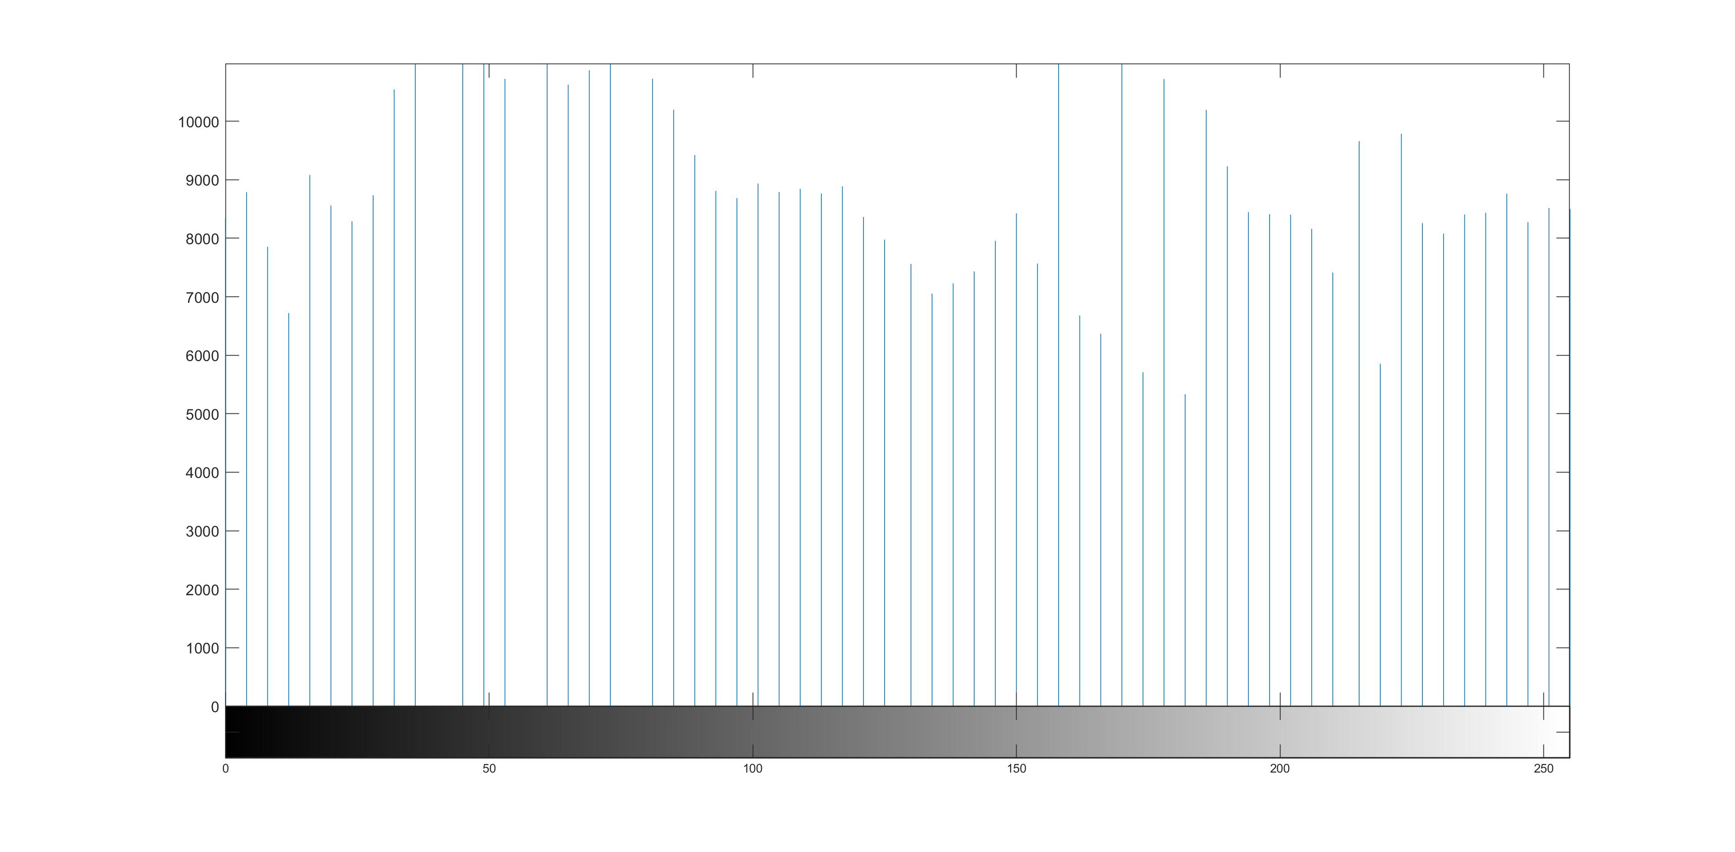

Slide 20
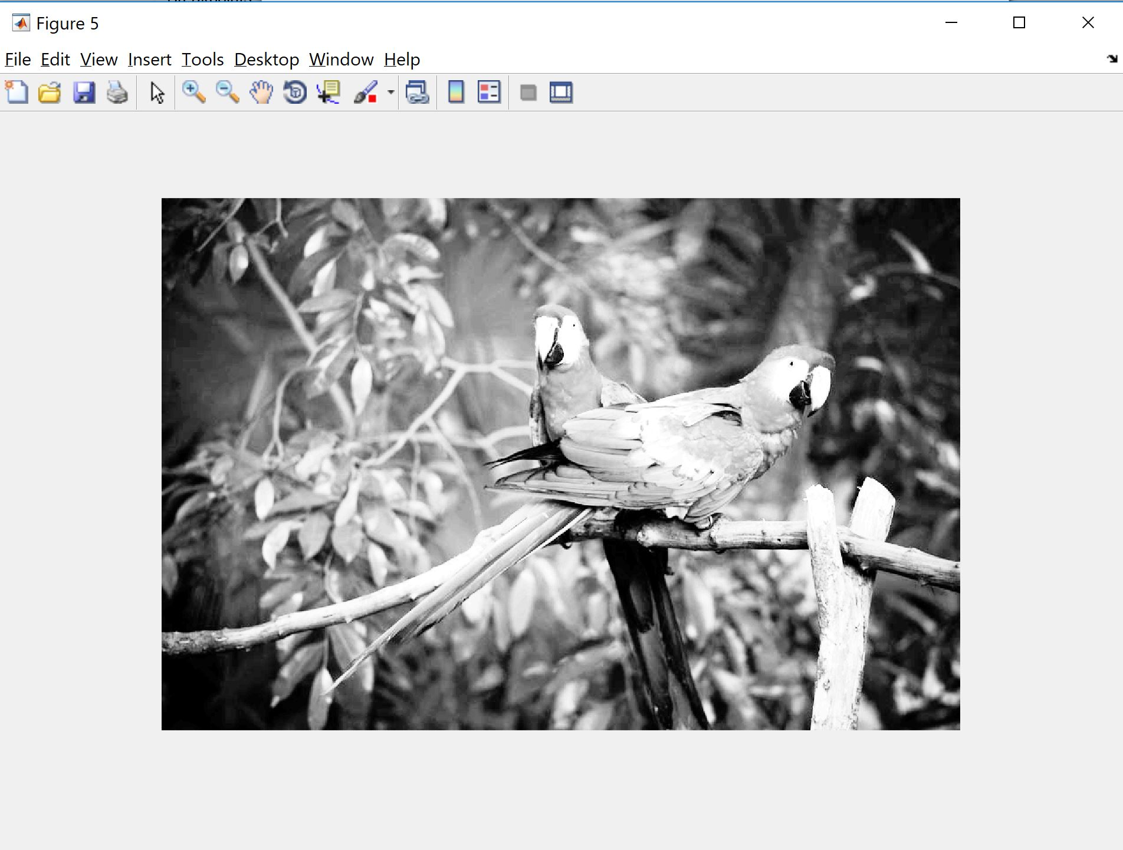

Slide 21
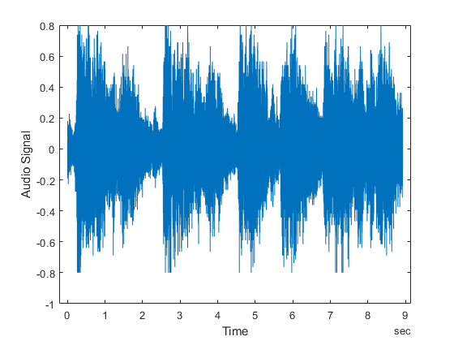
Basic Audio Processing
Just like images, audio is nothing but a vector (for one channel audio) or two vectors (for two channels, stereo audio) of numerical values.
MATLAB can import/export a variety of formats:
WAVE, OGG, FLAC, AU, MP3

Slide 22
Read and Play an Audio File
You can read an audio file with audioread function. It gives you two outputs. Y is the audio file data in terms of intensity and Fs is the “sampling rate.”
“Sampling rate” specifies how fast we should read data from y. The “sampling rate” is usually 44,100, which means in one second, 44,100 samples will be read from the vector y.
[y, Fs] = audioread('trains_short.mp3’);
We can plot y(blue and orange is for channel 1 and 2):
plot(y)

Slide 23
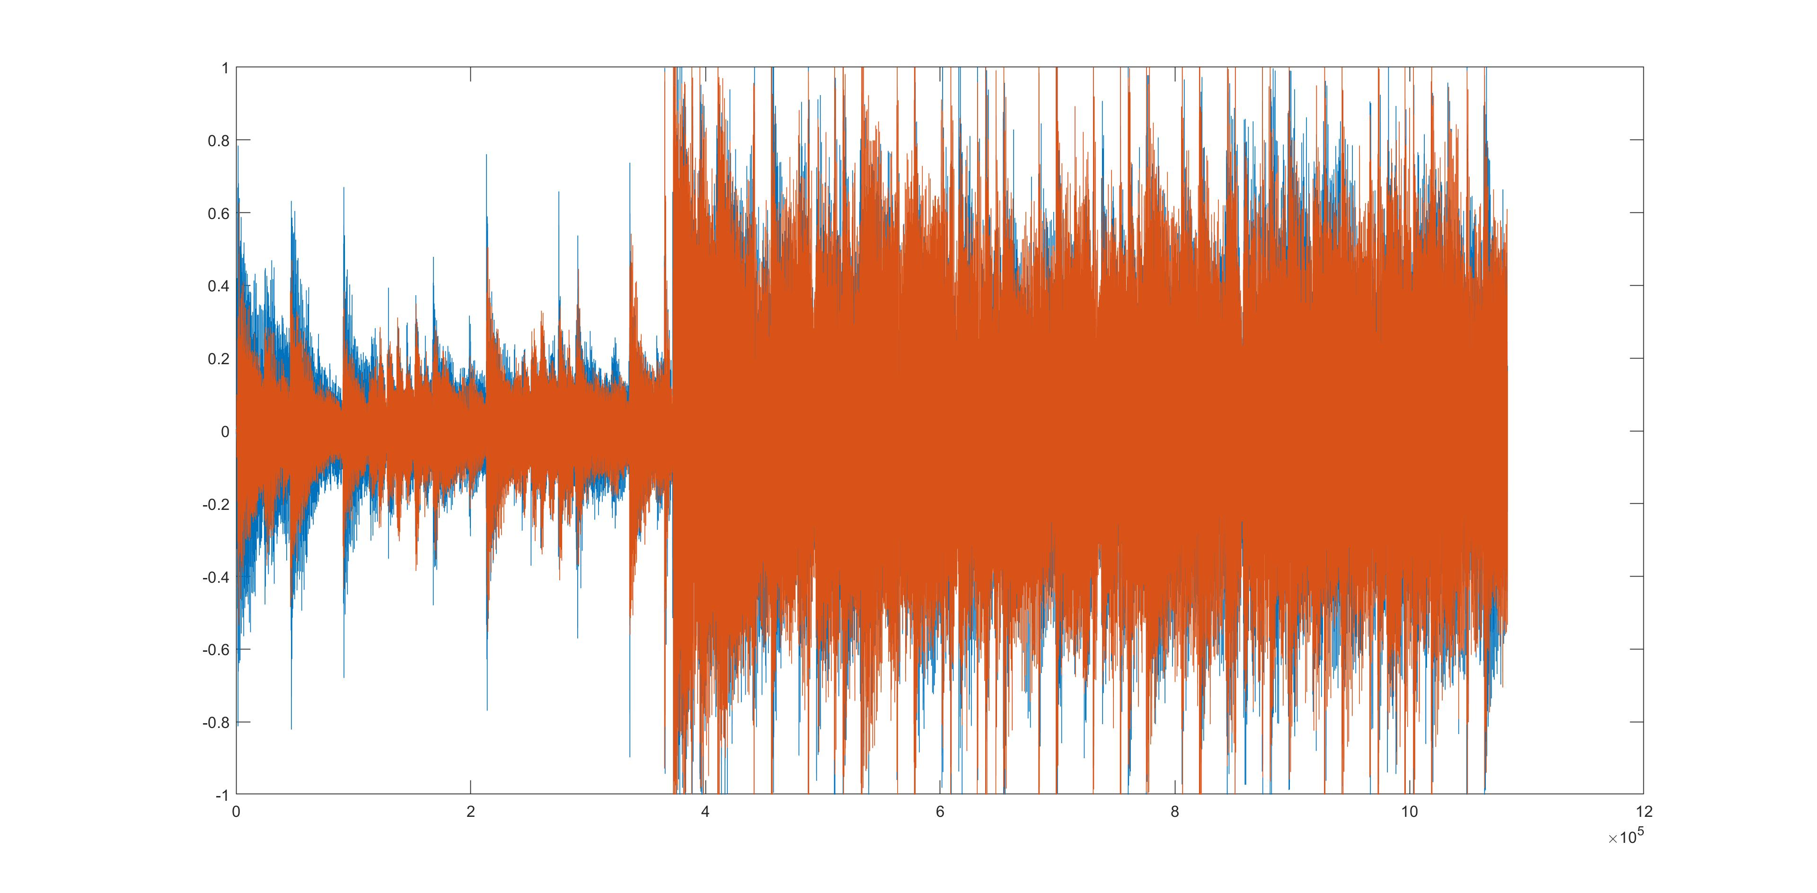

Slide 24
Read and Play an Audio File
And then we can play it with the sound function:
sound(y, Fs)
(WARNING: when you run this function it will play the whole audio, there is no way of stopping it, except killing MATLAB)
So, the length of audio the audio file in seconds is:
audio_length_in_sec = length(y)/Fs;

Slide 25
Trimming the audio file
Again, because y is just a vector of numbers we can perform any kind of math on it.
For start, we can trim an audio file from 5 to 10 second:
start_time = 5*Fs;
end_time = 10*Fs;
y_short = y(start_time:end_time, :);
sound(y_short, Fs);

Slide 26
Save audio file to disk
We can save the result using the audiowrite function:
audiowrite('train_short.wav', y_short, Fs);
We can also turn off one channel:
y_short(:, 1)=0;
We can just copy one column to a new vector to have a mono audio file instead of stereo.

Slide 27
Reverse the audio
We can reverse the audio file:
y_short_reversed = y_short(end:-1:1, end:-1:1);
Here we reversed both channels.

Slide 28
Adding noise to audio
We can add white noise to the audio file:
white_noise = randn(length(y_short), 2)*0.1;
y_noised = y_short + white_noise;
sound(y_noised, Fs)
Removing the noise is also possible but requires more advanced techniques which is beyond the scope of this tutorial.

Slide 29
Chaning the sampling rate
And finally, we can change the sampling rate which determines the frequency of the audio file.
sound(y_short, Fs/2) %low frequency
sound(y_short, Fs*2) %high frequency

Slide 30
Basic Video Processing
Any video consists of a bunch of frames and frames are images.
So, a video is a 4D image with the dimensions of Height x Width x Channel x time.
In MATLAB we can read video files using the following commands:
v = VideoReader('cats.mp4');
cat_video = read(v);
cat_video variable is a 4d matrix. For large files it is recommended to read frame by frame than loading the whole video in one variable.

Slide 31
Basic Video Processing
You can check the size of this 4d matrix by:
size(cat_video)
We can display the tenth frame using the following command:
imshow(cat_video(:,:,:,10))
v is an object and contains different information about the video. For example we can check frame rate. Frame rate is like sampling frequency and shows how many frames should be displayed in one second.
v.FrameRate

Slide 32
Play video
To have a smooth video we need at least 30 frames per second.
Now, we can play the video by showing each frame in 1/FrameRate seconds. To this end, we can write:
currAxes = axes;
while hasFrame(v)
video_frame = readFrame(v);
image(video_frame, 'Parent', currAxes);
%imshow(vidFrame) %this function is not efficient but works
pause(1/v.FrameRate);
end

Slide 33
Play video(cont)
hasFrame checks if there is any frames left in the matrix v
readFrame read one frame into the video_frame matrix(which is a color image) then display the image with image function. We can also use imshow but it is inefficient for rendering many frames(=pictures) in a short span of time.
Then we pause for 1/30 seconds and then continue to show the next frame.
The MATLAB code is very intuitive in the way that how we understand video in general.

Slide 34
Create animations and save them
In the same way as image and audio files we can write video files. We use VideoWriter in this case. For example we can record the evolution of a function with respect to some parameters in MATLAB into a video file. Here we create a simple animation of the sine function as k changes.
v = VideoWriter('peaks.avi');
open(v);
t = 0:0.1:10;
for k = 1:20
plot(sin(k*t))
frame = getframe(gcf);
writeVideo(v,frame);
end
close(v);

Slide 35
Create animations and save them
We first open the v handle to insert frames in it.
Then in the for loop after plotting each sin(k*t) we get the frame using getframe function and write it into v.
Finally we close the video file to make sure it is saved on disk.

